Slide 1
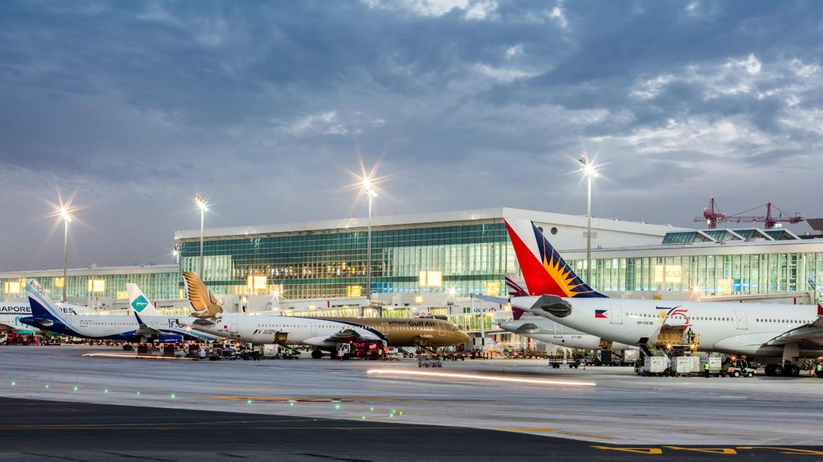
Predicting Upcoming Flight Delays
Shalini Jain
DATA 606 - Delivery 1

Slide 2

Project Goal
To predict upcoming flight delays based on previous delays and cancellations
Prevent future delays
Help consumers know which airlines to use/avoid

Slide 3
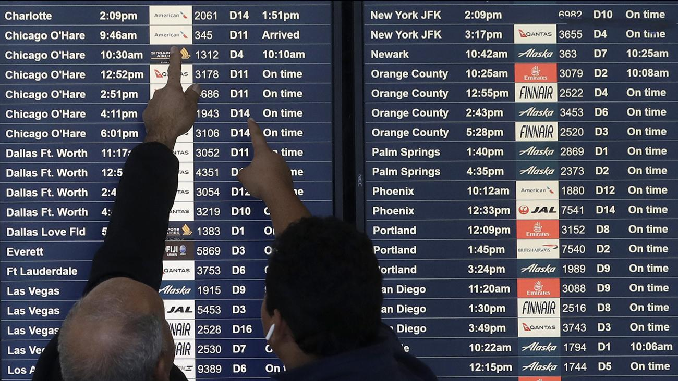
About the Dataset
2015 Flight Delays and Cancellations
U.S. Department of Transportation (DOT) Bureau of Transport
On-time, delayed, canceled, and diverted flights
3 CSVs
Airlines
Airports
Flights

Slide 4
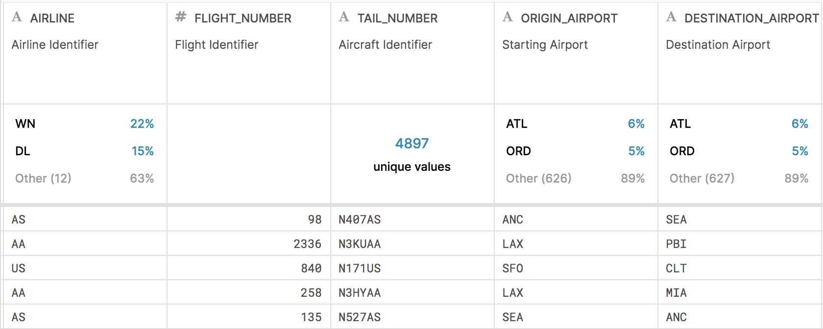
***Flights CSV***

Slide 5
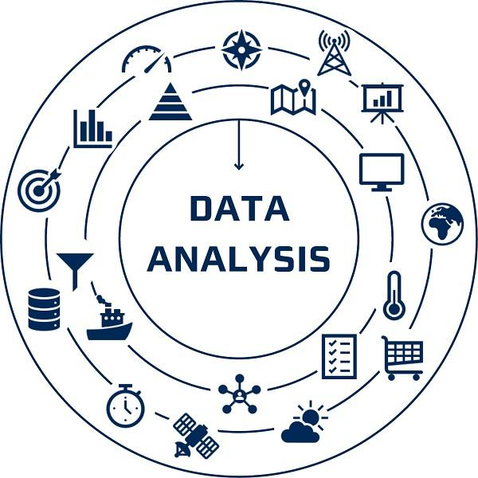
Analysis & Testing
Setting up environment
Cleaning up the datasets
Machine Learning, ALS

Slide 6
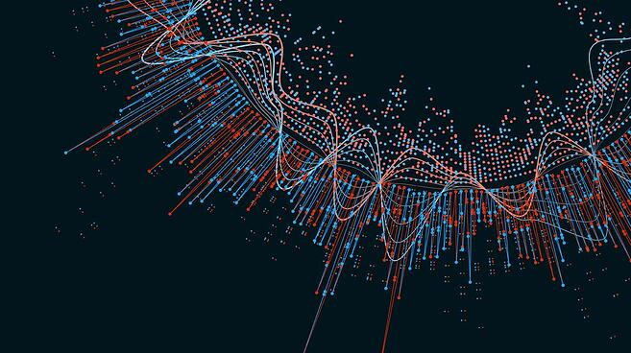
Visualizations

Slide 7

Questions?
Please contact me via email: sjain3@umbc.edu

Slide 8
Resources
https://www.kaggle.com/usdot/flight-delays#airlines.csv

